Slide 1




Slide 2




Slide 3
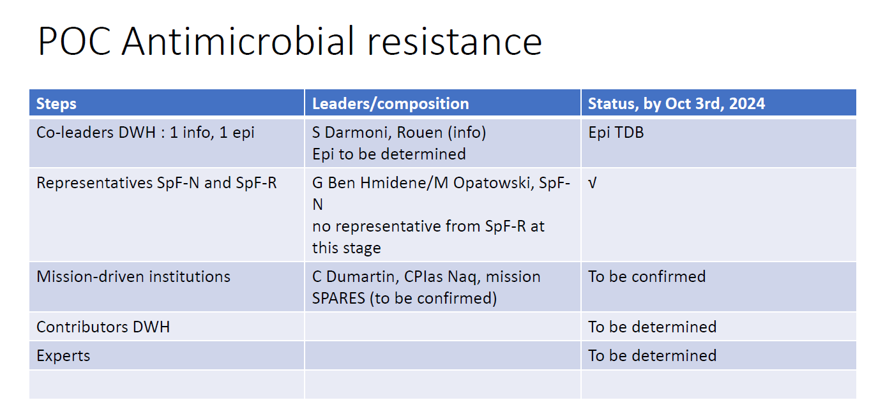

Slide 4
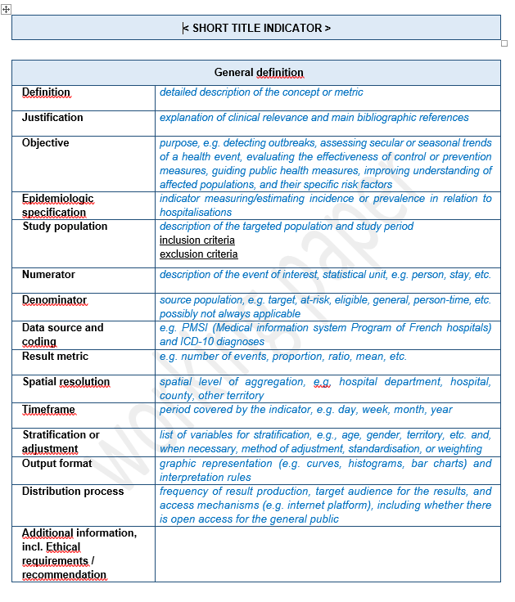


Slide 5
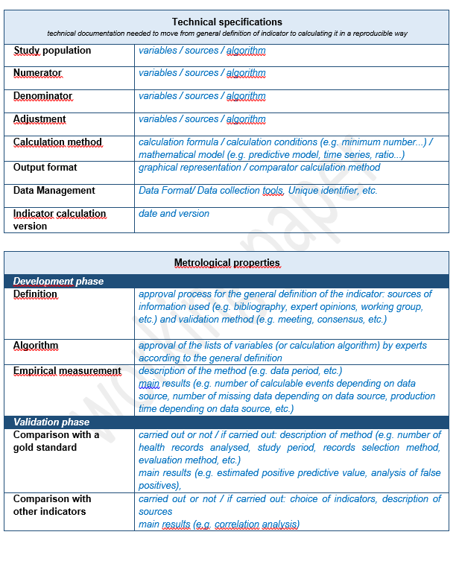
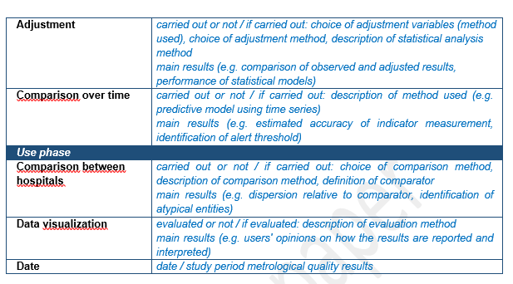

Slide 6
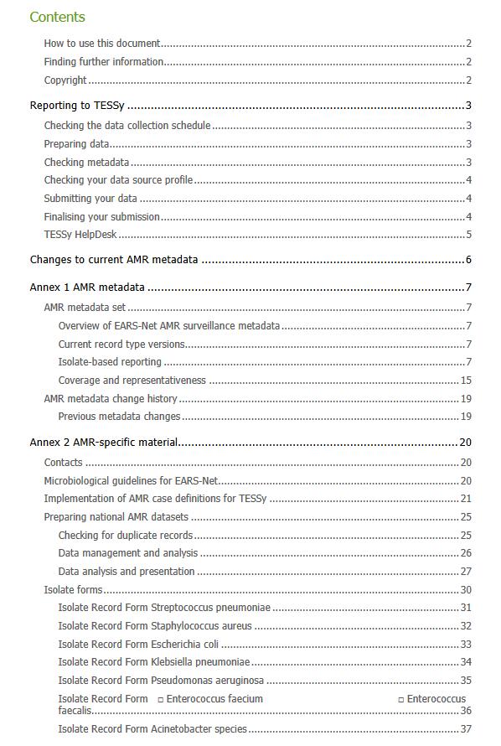

https://www.ecdc.europa.eu/sites/default/files/documents/ears-net-reporting-protocol-2021.pdf

